Slide 1
Food and drink
Клуб английского языка

Slide 2
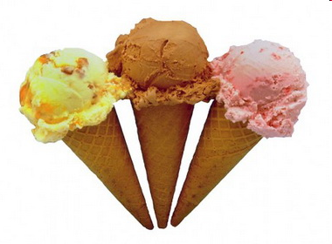
ice cream

Slide 3
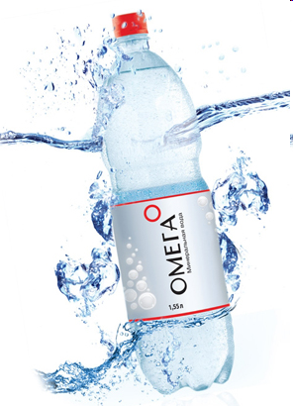
mineral water

Slide 4
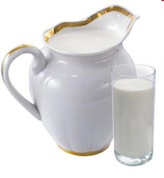
milk

Slide 5
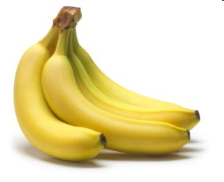
bananas

Slide 6
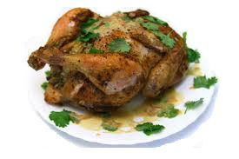
chicken

Slide 7
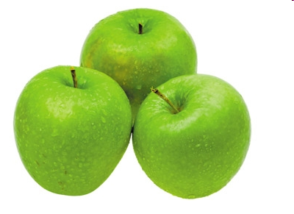
apples

Slide 8
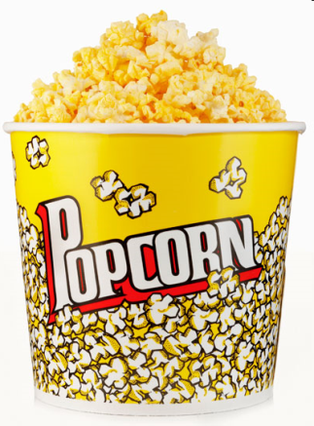
popcorn

Slide 9
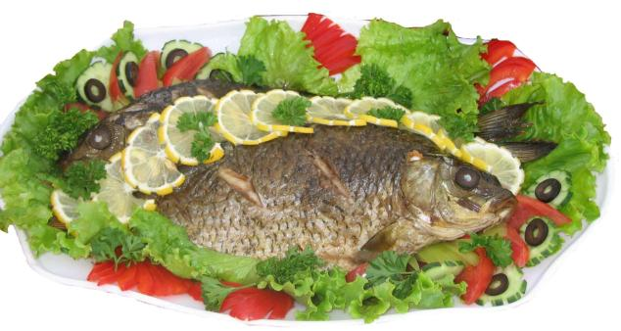
fish

Slide 10
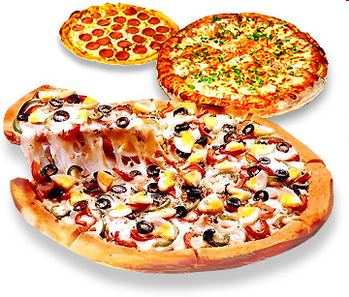
pizza

Slide 11
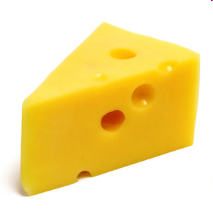
cheese

Slide 12
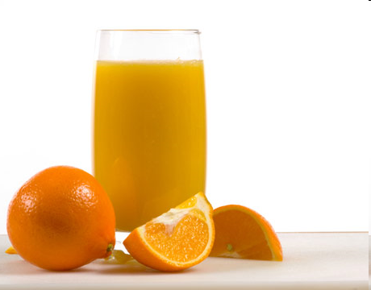
orange juice

Slide 13
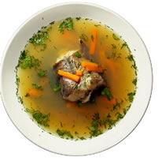
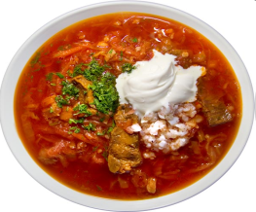
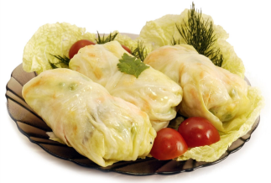
Russian food
Fresh-soup
Kasha
Borscht
Pancakes
Stuffed cabbage
Pelmeni

Slide 14
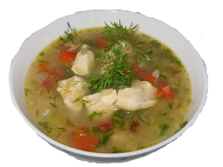
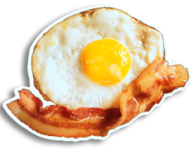
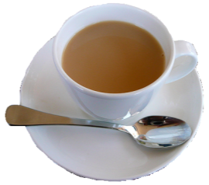
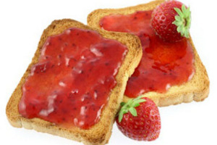
English food
Porridge
Chicken soup with onion
Bacon and eggs
Tea with milk
Pudding
Toast and jam

Slide 15
Do you like… ?
Yes, I do.
No, I don’t.

Slide 16
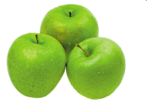
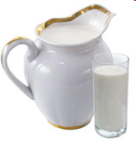
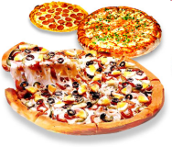
The chant
Do you like ?
Do you like ?
Do you like ?

Slide 17
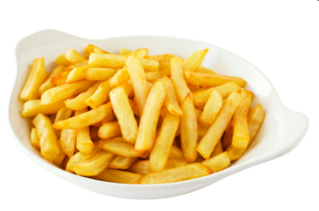
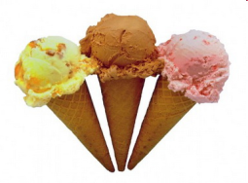
What’s your favourite food?
My favourite food is…

Slide 18
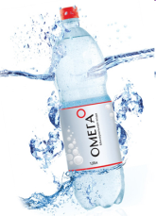
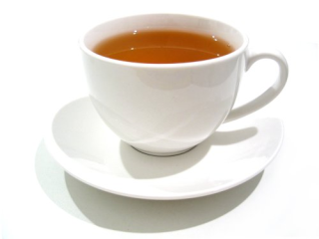
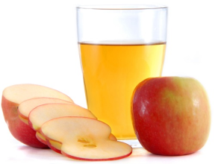
What’s your favourite drink?
My favorite drink is…

Slide 19
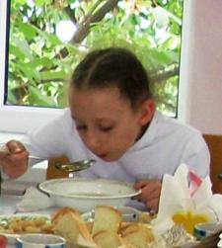
About myself
I like I don’t like My favourite
I like chicken and bananas.
I don’t like fish and cheese.
My favorite food is pizza.
My favorite drink is apple juice.

Slide 20
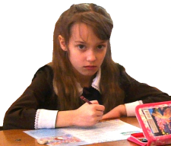
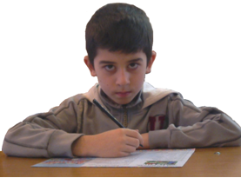
Complete
favourite food
apples
favourite drink
like
don’t
I … fish
and chips.
I … like pizza or … .
My …… is milk.
My …… is chicken.

